Slide 1

Chapter 2:
Introduction
to
C++

Slide 2
2.1
The Parts of a C++ Program

Slide 3
The Parts of a C++ Program
// sample C++ program
#include <iostream>
using namespace std;
int main()
{
cout << "Hello, there!";
return 0;
}
comment
preprocessor directive
which namespace to use
beginning of function named main
beginning of block for main
output statement
string literal
Send 0 to operating system
end of block for main

Slide 4
Special Characters
Character | Name | Meaning
// | Double slash | Beginning of a comment
# | Pound sign | Beginning of preprocessor directive
< > | Open/close brackets | Enclose filename in #include
( ) | Open/close parentheses | Used when naming a function
{ } | Open/close brace | Encloses a group of statements
" " | Open/close quotation marks | Encloses string of characters
; | Semicolon | End of a programming statement

Slide 5
2.2
The cout Object

Slide 6

The cout Object
Displays output on the computer screen
You use the stream insertion operator << to send output to cout:
  cout << "Programming is fun!";

Slide 7
The cout Object
Can be used to send more than one item to cout:
  cout << "Hello " << "there!";
  Or:
  cout << "Hello ";
  cout << "there!";

Slide 8
The cout Object
This produces one line of output:
cout << "Programming is ";
cout << "fun!";

Slide 9
The endl Manipulator
You can use the endl manipulator to start a new line of output. This will produce two lines of output:
cout << "Programming is" << endl;
cout << "fun!";

Slide 10

The endl Manipulator
cout << "Programming is" << endl;
cout << "fun!";
Programming is
fun!

Slide 11
The endl Manipulator
You do NOT put quotation marks around endl
The last character in endl is a lowercase L, not the number 1.
endl
This is a lowercase L

Slide 12
The \n Escape Sequence
You can also use the \n escape sequence to start a new line of output. This will produce two lines of output:
cout << "Programming is\n";
cout << "fun!";
Notice that the \n is INSIDE
the string.

Slide 13
The \n Escape Sequence
cout << "Programming is\n";
cout << "fun!";
Programming is
fun!

Slide 14
2.3
The #include Directive

Slide 15
The #include Directive
Inserts the contents of another file into the program
This is a preprocessor directive, not part of C++ language
#include lines not seen by compiler
Do not place a semicolon at end of #include line

Slide 16
2.4
Variables and Literals

Slide 17
Variables and Literals
Variable: a named memory location
  Has a name and a type of data it can hold
  Must be defined before it can be used:
  int item;

Slide 18
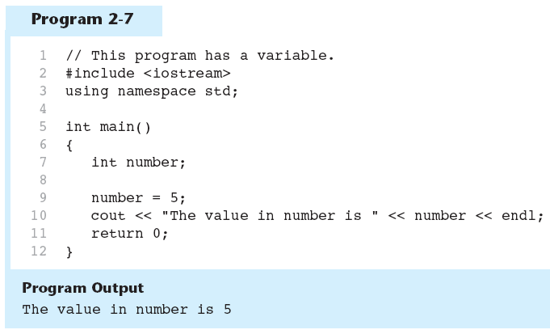
Variable Definition in Program 2-7
Variable Definition

Slide 19
Literals
Literal: a value that is written into a program’s code.
"hello, there" (string literal)
12 (integer literal)

Slide 20
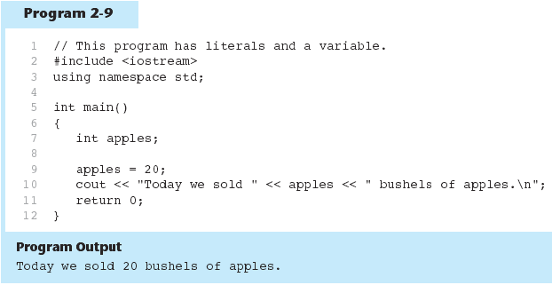
Integer Literal in Program 2-9
20 is an integer literal

Slide 21
String Literals in Program 2-9
These are string literals

Slide 22
2.5
Identifiers

Slide 23
Identifiers
An identifier is a programmer-defined name for some part of a program: variables, functions, etc.

Slide 24
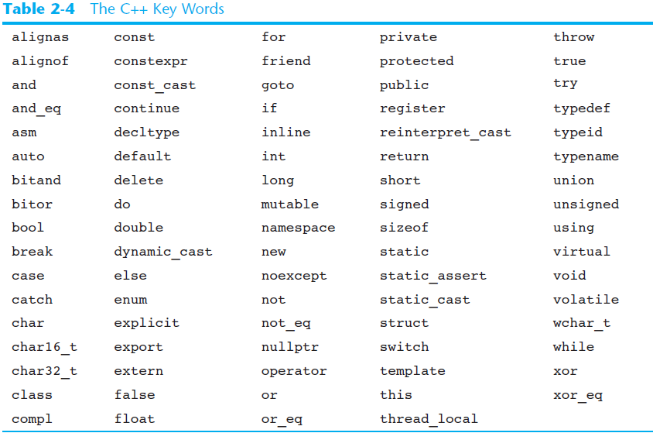
C++ Key Words
You cannot use any of the C++ key words as an identifier. These words have reserved meaning.

Slide 25
Variable Names
A variable name should represent the purpose of the variable. For example:
itemsOrdered
The purpose of this variable is to hold the number of items ordered.

Slide 26
Identifier Rules
The first character of an identifier must be an alphabetic character or and underscore ( _ ),
After the first character you may use alphabetic characters, numbers, or underscore characters.
Upper- and lowercase characters are distinct

Slide 27
Valid and Invalid Identifiers
IDENTIFIER | VALID? | REASON IF INVALID
totalSales | Yes
total_Sales | Yes
total.Sales | No | Cannot contain .
4thQtrSales | No | Cannot begin with digit
totalSale$ | No | Cannot contain $

Slide 28
Naming Conventions for Multiword variables
Style Name | Example
Pascal | ThisIsMyVariable
Camel case | thisIsMyVariable
Underscore | this_is_my_variable
Underscore (upper case) | THIS_IS_MY_VARIABLE
Use camel case for variable and function definitions
Use Pascal styles for struct and class declarations
Use Underscore Upper case for constant variable definitions

Slide 29
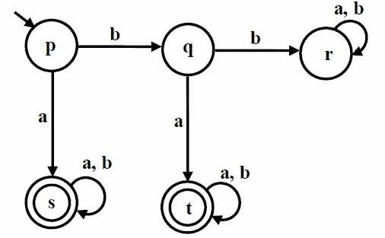
Deterministic Finite State Machines
Computers are deterministic finite state machines
Deterministic Finite State Machines
  Given a set of states and a set of inputs. It is possible to determine the next state from the current state if the input is known.
The state of a computer can be viewed as its
current memory contents
By changing the contents of a computer’s
memory, the state of the computer is changed
Programming can be viewed as the manipulation
of the computer’s memory

Slide 30
Computer Memory
Most programming is concerned with primary memory (RAM)
Modern computers are byte addressable
  Each byte of RAM has its own memory address
  A 32-bit computer has 2^32 addresses (approximately 4 billion)
  A 64-bit computer has 2^64 addresses (approximately 18 quintillion, which is 18 million tera bytes)
A byte is made of 8 bits.
A bit can have one or two values: 0 or 1.
Bytes, not bits, have addresses.

Slide 31
Computer Memory
A bit is a 0 or 1
A byte is 8 bits
A kilobyte is 1024 (2^10) bytes
A megabyte is 1048576 (2^20) bytes
  1024 kilobytes
A gigabyte is 1073741824 (2^30) bytes
  1048576 kilobytes
  1024 megabyte
A terabyte is 1099511627776 (2^40) bytes
  1073741824 kilobytes
  1048576 megabytes
  1024 gigabytes

Slide 32
Computer Memory
Petabyte (2^50)
Exabyte (2^60) – A 64-bit computer can theoretically have up to 16 exabytes of memory
Zetabyte (2^70)
Yobibyte (2^80)

